Slide 1
Who are we?
How do we include people in our work
Mel Hughes
October 16th 2026

Slide 2
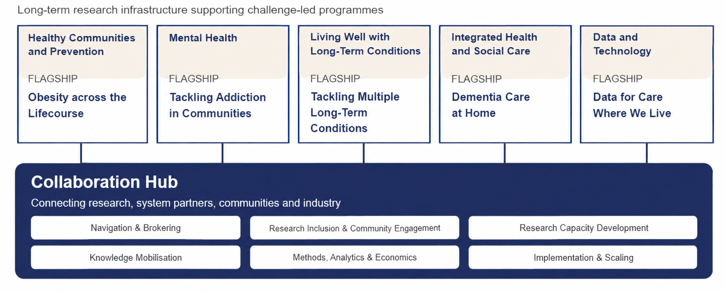
Five themes, five Flagships, one connected infrastructure

Slide 3
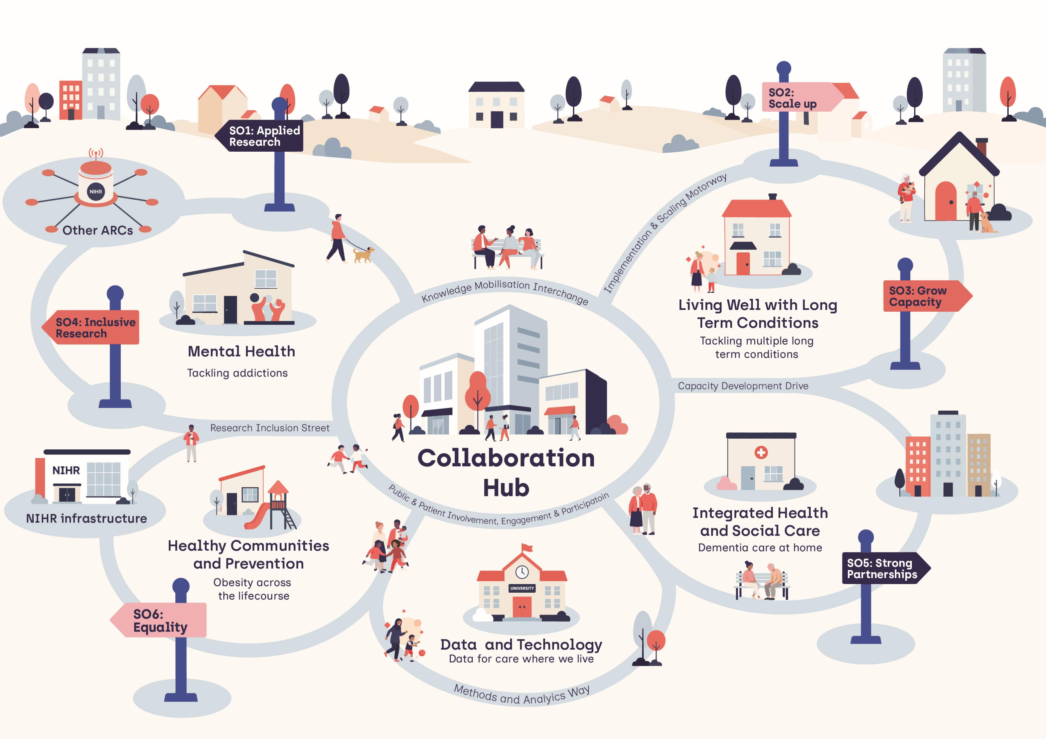
The New NIHR ARC:Wessex (2026-2031)

Slide 4
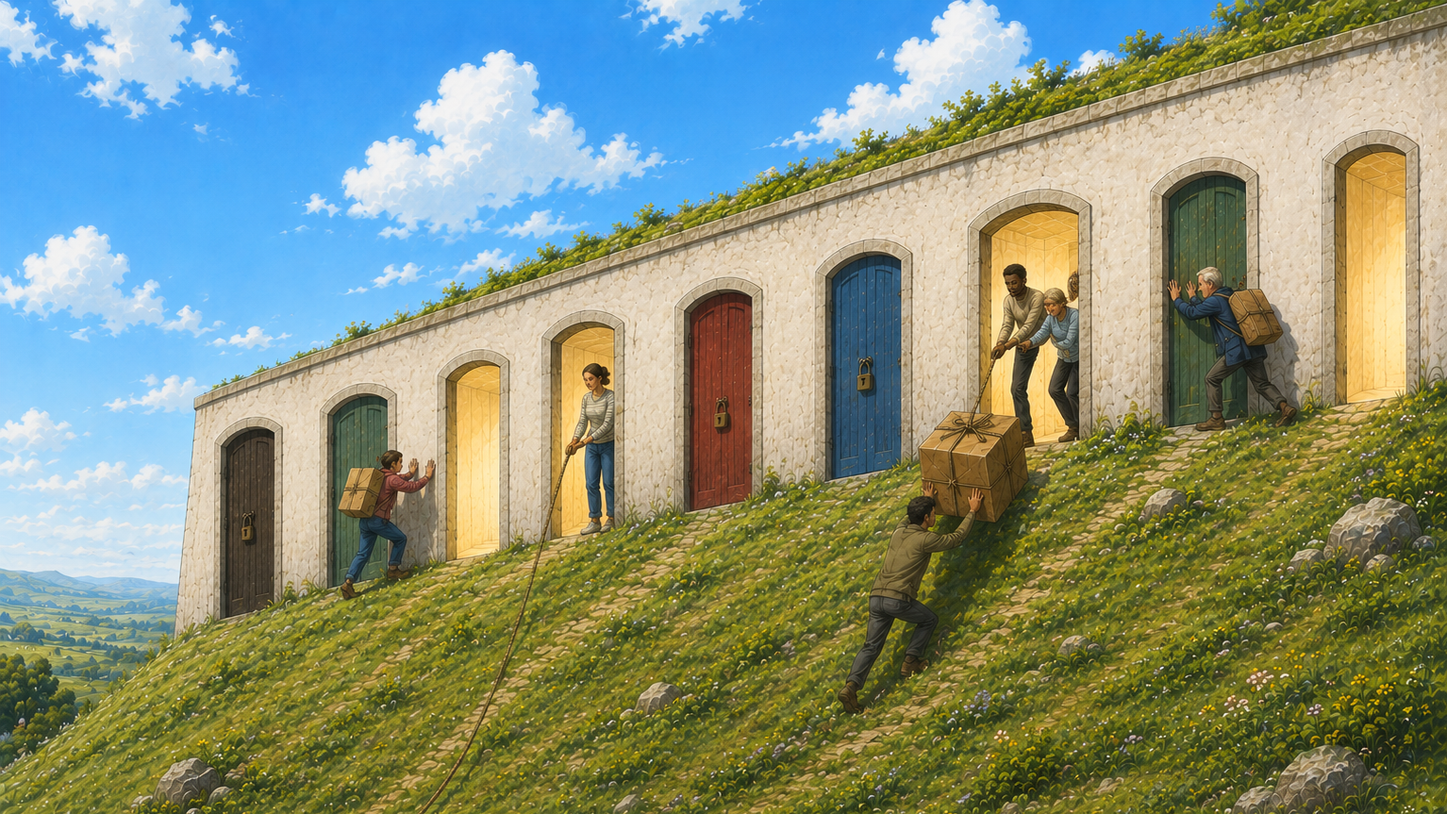
Push & Pull: Real-world systems are often not ready for change
The Push & Pull of System Transformation
Some opportunities remain hidden
Systems have open and closed doors
More Really
Important
Research
Really
Important
Research
Flagship co-design helps line people up at open doors
Collaborators pull on nothing
Researchers don’t know where to push
Flagship co-production turns opportunities into real-world change

Slide 5
Ensure that research findings apply to everyone
By Increasing the diversity of who participates in research
By Increasing the diversity who designs research
By Increasing the diversity who conducts research
Source: ARC Wessex
RI strategy, Bournemouth University
Accessible participation pathways
(Collaboration Hub)
Codesign neighbourhood systems
(Flagship Codesign)
Accessible studies including Community Led research
(Flagship Coproduction)

